Slide 1
MAAME AFUA S. KOME-MENSAH
Web Tech Summer 2025 Final Exams

Slide 2
Maame Afua is building ConsultEASE – a website that helps individuals interact with business consultants in our company without needing personal connections.
It solves the frustrating search for professional advice by creating a simple platform where clients can easily book consultations, and consultants can have sessions with them to share structured guidance – all in one organized place

Slide 3
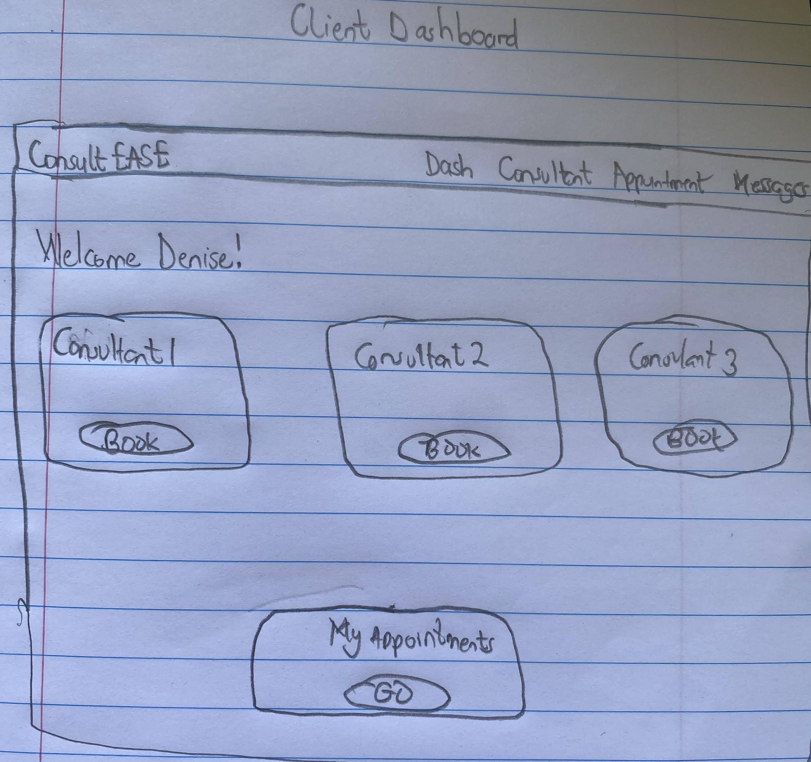
ConsultEase
Clients: Can easily find and book consultants 24/7, communicate directly through the platform, track appointment history, and provide/receive feedback—all in one organized place.
Consultants: Better manage their availability and workload, reduce back-and-forth communication, maintain professional records of sessions, and access minimal analytics about their bookings.
Administrators: Have full oversight of platform operations, can ensure quality control, and access system-wide data for better decision-making.
Overall: The platform creates efficiency, transparency, and accessibility that didn't exist before.
ddd
Difficulty accessing consulting advice in an organized manner
Confusion around consultant availability
Poor workload management for consultants
Lack of digital trail for tracking problems and feedback
Limited accessibility for people without time or resources to find consultants traditionally
Scattered communication across multiple platforms (emails, WhatsApp, etc.)
Clients: Individuals or businesses seeking professional consulting services.
Consultants: Certified professionals offering consulting services in various fields. They need to manage their availability, appointments, and client communications efficiently.
Administrators: Platform managers who oversee system operations, user management, and ensure smooth functioning of the platform.
Draw screen showing client’s dashboard that has an easy interface to see the different consultants you can book, and a card that allows you to quickly see all your appointments. There is also a nav bar that allows clients to access more features like the messaging tabs etc.
PROBLEM SOLVED
WHY USERS ARE BETTER OFF
USERS

Slide 4
About ConsultEase
ConsultEASE Platform
This is a consultancy matchmaking service that connects Ghanaian business owners with business consultants in my consulting firm. Its purpose is to democratize access to professional business advice by removing networking barriers through technology.
Services Provided:
Consultant discovery and matching
Appointment scheduling and management
Secure messaging between clients and consultants
Feedback feature
Admin control (managing users, audit logs)

Slide 5
User / Customer
Clients | Business owners who book consultations to get professional advice for their companies.
Consultants | Experts from ConsultEase who offer their business advice through scheduled sessions and provide structured feedback.
Administrators | Platform managers who oversee all users, approve users , and ensure system integrity.

Slide 6
Main Functions of the Website
1. CONSULTANT DISCOVERY SYSTEM : Browse verified experts without personal connections
2. TRANSPARENT AVAILABILITY CALENDAR: Book real time slots with a live calendar, preventing past date and time bookings (GMT)
3. ONE-CLICK BOOKING SYSTEM: Reserve sessions instantly with confirmed time slots without double booking
4. INTEGRATED MESSAGING: Secure communication within the platform between clients and consultants

Slide 7
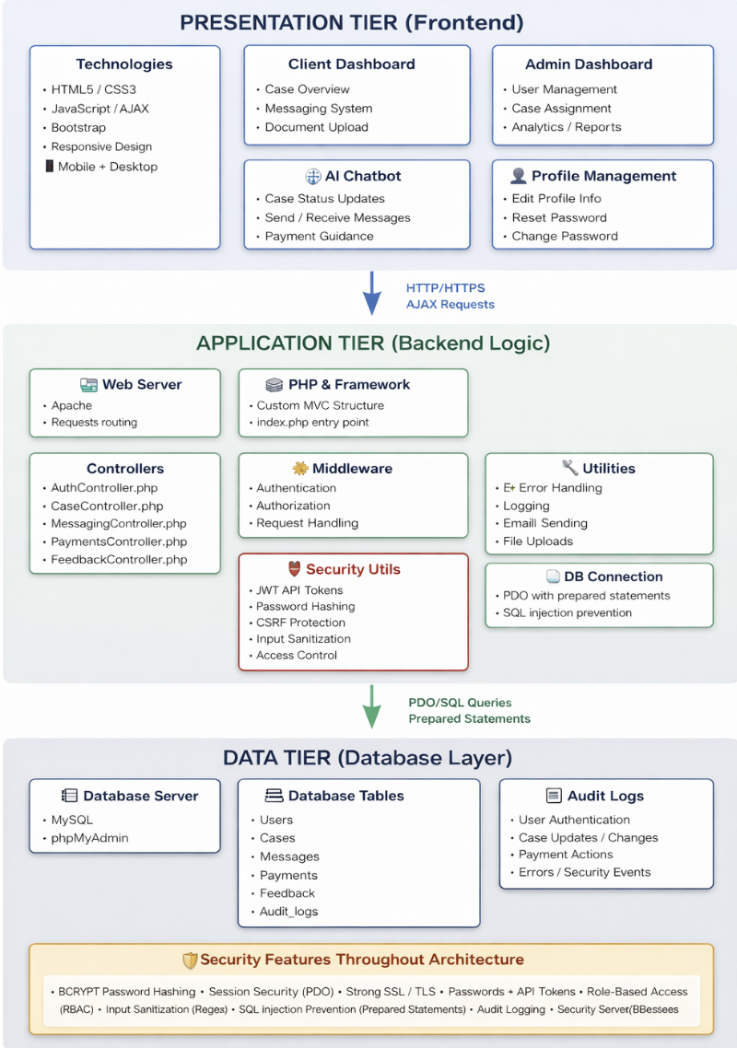
Architecture

Slide 8
